Slide 1



TYPESCRIPT AND REACT STATE
LESSON 9
CFGDEGREE → FULL-STACK STREAM

Slide 2

AGENDA
01 Introducing State and why it’s needed
02 Introduction to class components
03 Creating a class component with a state
04 Overview of TypeScript and its importance

Slide 3

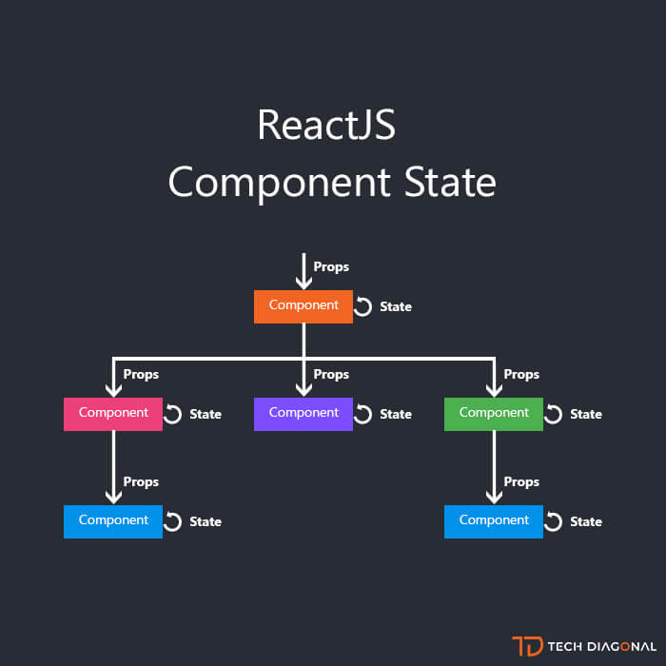
Introducing State
One of React’s most coolest parts!
Components have a paired element to them called the state - this is a object that contains information and attributes about the component
This state can change over time (e.g. through modification, perhaps we increment a value that’s stored inside it) - when this occurs, the component re-renders
Consider it like the components information bank - I can store the components text, attributes and anything inside its state. The bonus is that when these critical values update, so does the component
Props and state are very similar - they’re objects that store information (which can influence the output of a render)! The difference is that props get passed to the component (similar to function parameters) whereas state is managed within the component (similar to variables declared within a function).
# EXAMPLE

Slide 4
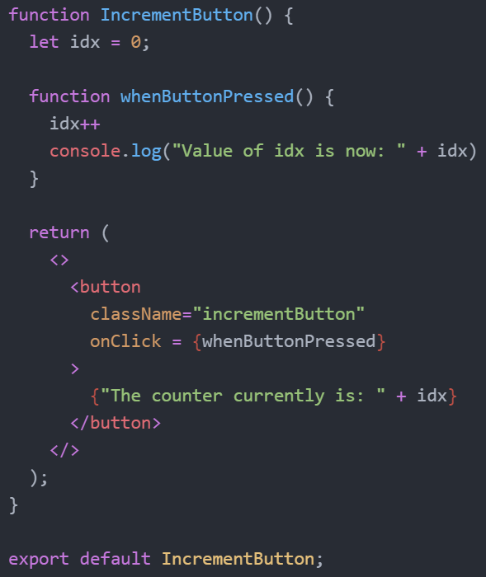
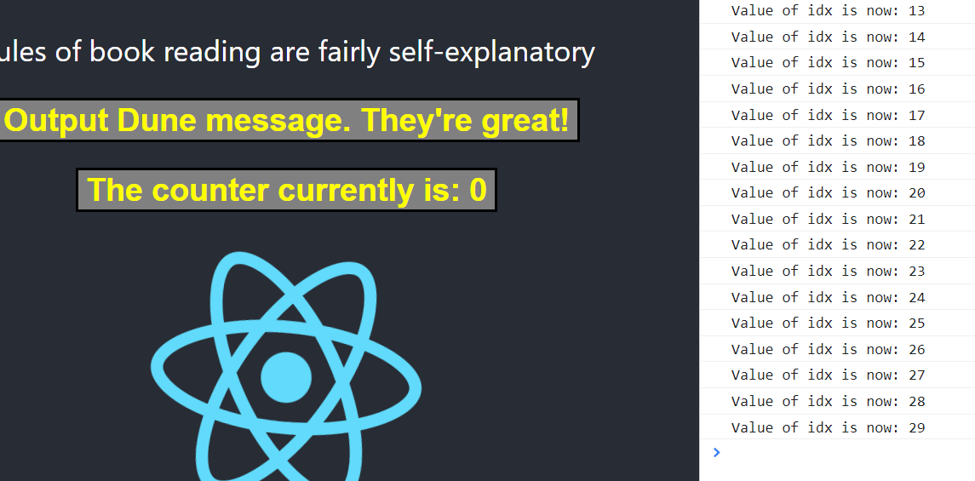

Demonstrating the need for State
Showcasing its need
# CODE AND RENDERED EXAMPLE
Let's say that I want to create a button whose value increments per click
The issue is that everytime I click, the variable increments but this change isn’t reflected in the button. Why?
Consider carefully as to why the button doesn’t show the change - the answer is why State is important in React

Slide 5
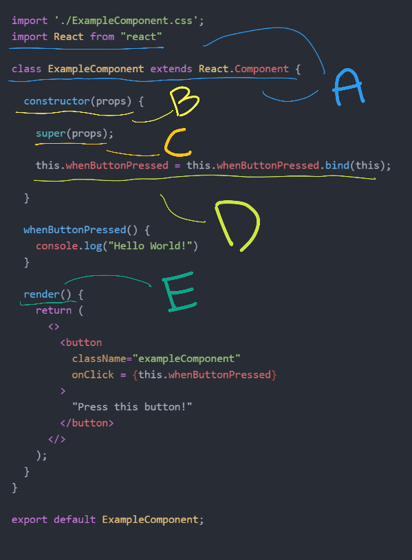
What are class components?
And how do they differ?
Before we start considering how to add state to our components, we need to first cover class components - this is because state cannot be added to a functional component (outside of mechanisms called ‘hooks’ which we’ll cover later).
A class component is simply just another approach to create a component - instead of writing the component code as a function, we write it as a class instead.
Consider the class component on the right and how it works!
(Your instructor can explain the critical parts pinpointed as A, B, C, D and E)

Slide 6
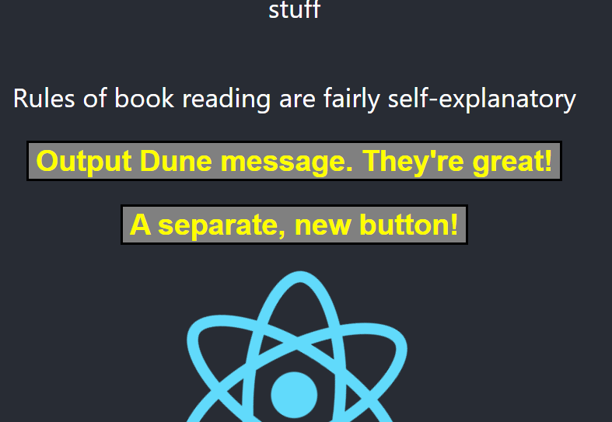

Exercise: Create a class component
Create a new button component - something like IncrementButton!
# EXAMPLE OUTPUT
We don’t need to do anything with the rest of our components, but this new button component that you should create (can look exactly like the previous button - feel free to reuse the CSS file) should be a class button instead.
Making use of what you’ve learnt from the previous slide, alongside Google and online documentation, create a new component that’s written in pure class code instead!
The text of this new button can be anything as well - the important part is that its code is class based instead of functional based!
You have approx. 15 minutes for this (depending on your instructor's discretion + current time!). Google when you can!

Slide 7
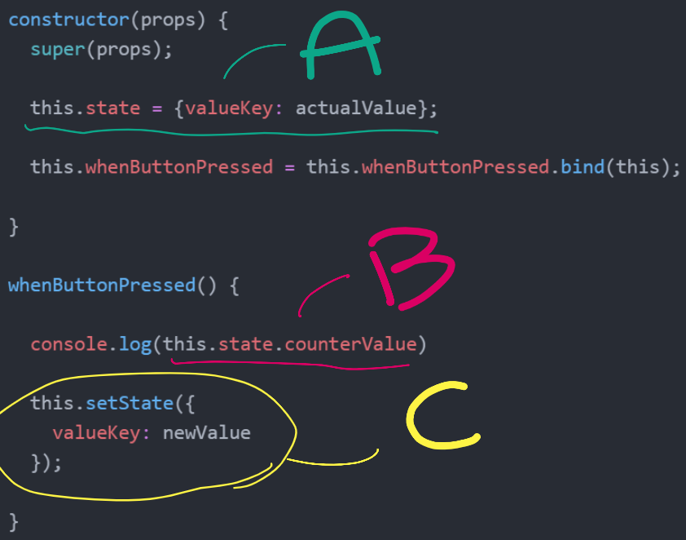
Walkthrough: State within class components
Actually using state properly now!
Now that we have our class component, we can start using state properly
Take a look at the right-hand side code; what does A, B or C mean? Before your instructor explains, take a moment to consider what each part is and why we need something like setState
Consider points like - why is it bad to change the state directly? Why can the state only be changed through setState ideally?

Slide 8
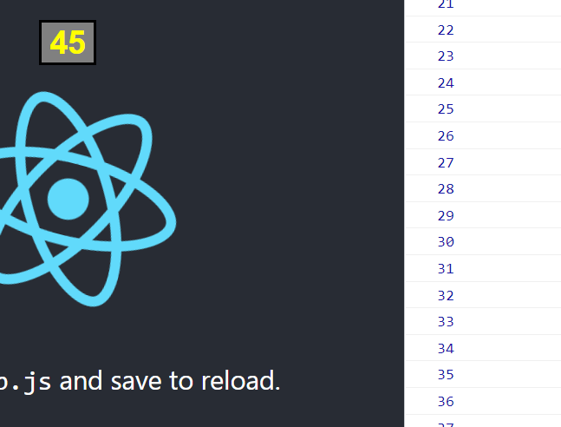
Exercise 2: Adding state to our button
Now we want to ensure that our button displays a counter that increments per click!
Modifying your previous class-component button earlier, make sure it now displays a counter that increments every time its clicked
You’ll need to use state for this - using a normal variable will not work as you need the component to re-render every time (in order to display the new increment value)
The appearance of the button can be anything - the only critical part is that it’s value increments per click
# EXAMPLE OUTPUT
You have approx. 15 minutes for this (depending on your instructor's discretion + current time!). Google when you can!

Slide 9
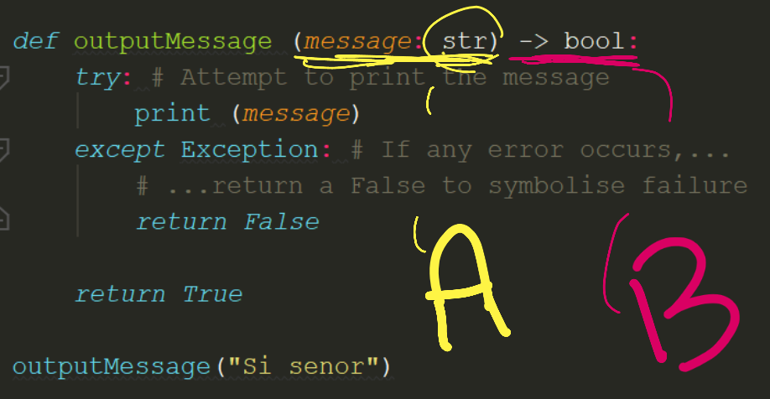
Introduction to TypeScript (Part 1)
In case JavaScript wasn’t bad enough!
In programming languages, parameters and values are often exchanged with no prior definition of what types these values are (e.g. I expect a string parameter, but the language doesn’t know it’s explicitly a string!).
In Statically Typed languages, we explicitly define the type of everything so that it’s known at compile time (e.g. this function expects two strings and 1 integer, and it’ll return 1 boolean).
Through this, we can catch bugs more easily! Particularly when data is mutated wrongly and becomes the wrong type
# EXAMPLE OF TYPE CHECKING IN PYTHON!

Slide 10
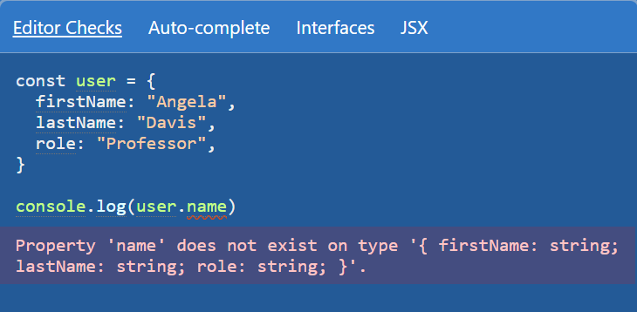
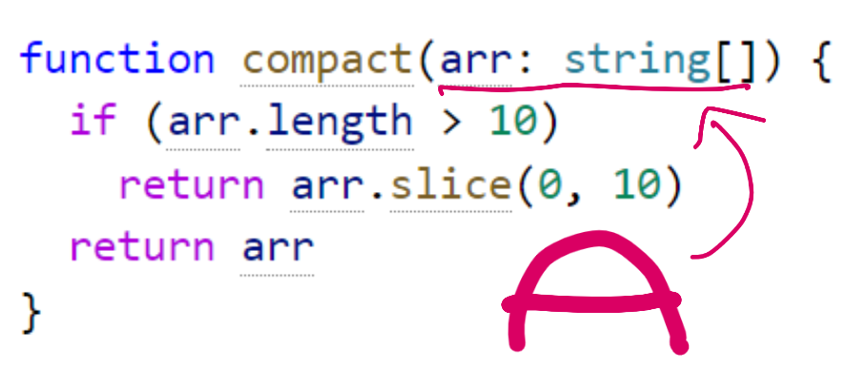
Introduction to TypeScript (Part 2)
In case JavaScript wasn’t bad enough!
# EXAMPLES OF TYPESCRIPT!
TypeScript is a implementation of this type-checking ability; it builds upon JavaScript (small further specialisation of the language) and gives us a JavaScript with syntax for types.
We won’t be able to work with it at the moment as setting it up would take too much time from other content, but it’s still important regardless that you’re aware of TS - and even ideally, make use of it in your projects!
By creating and defining everything with a type in our project (e.g. within files ending in .tsx - a cross mix between TS and JSX), we can create higher quality code; the lack of vagueness helps compilers eliminate bugs more easily / help us catch misunderstandings with ease!

Slide 11
SUMMARY
Components can have data assigned to them through States - these are just like variables, except changes to them trigger component re-renders (allowing us to update it dynamically)
Components can also be written in a class format - this is necessary if we want to use state within the component
TypeScript is a superset of the JS language - it can be added as a complement in future languages, allowing us to define the code we write explicitly in a bid to improve its quality and eliminate number of bugs that could occur
If there’s spare time, continue working on your group projects!

Slide 12
THANK YOU!

